Slide 1
QI Project
Getting the diagnosis right for patients on the COPD register
[your name]

Slide 2
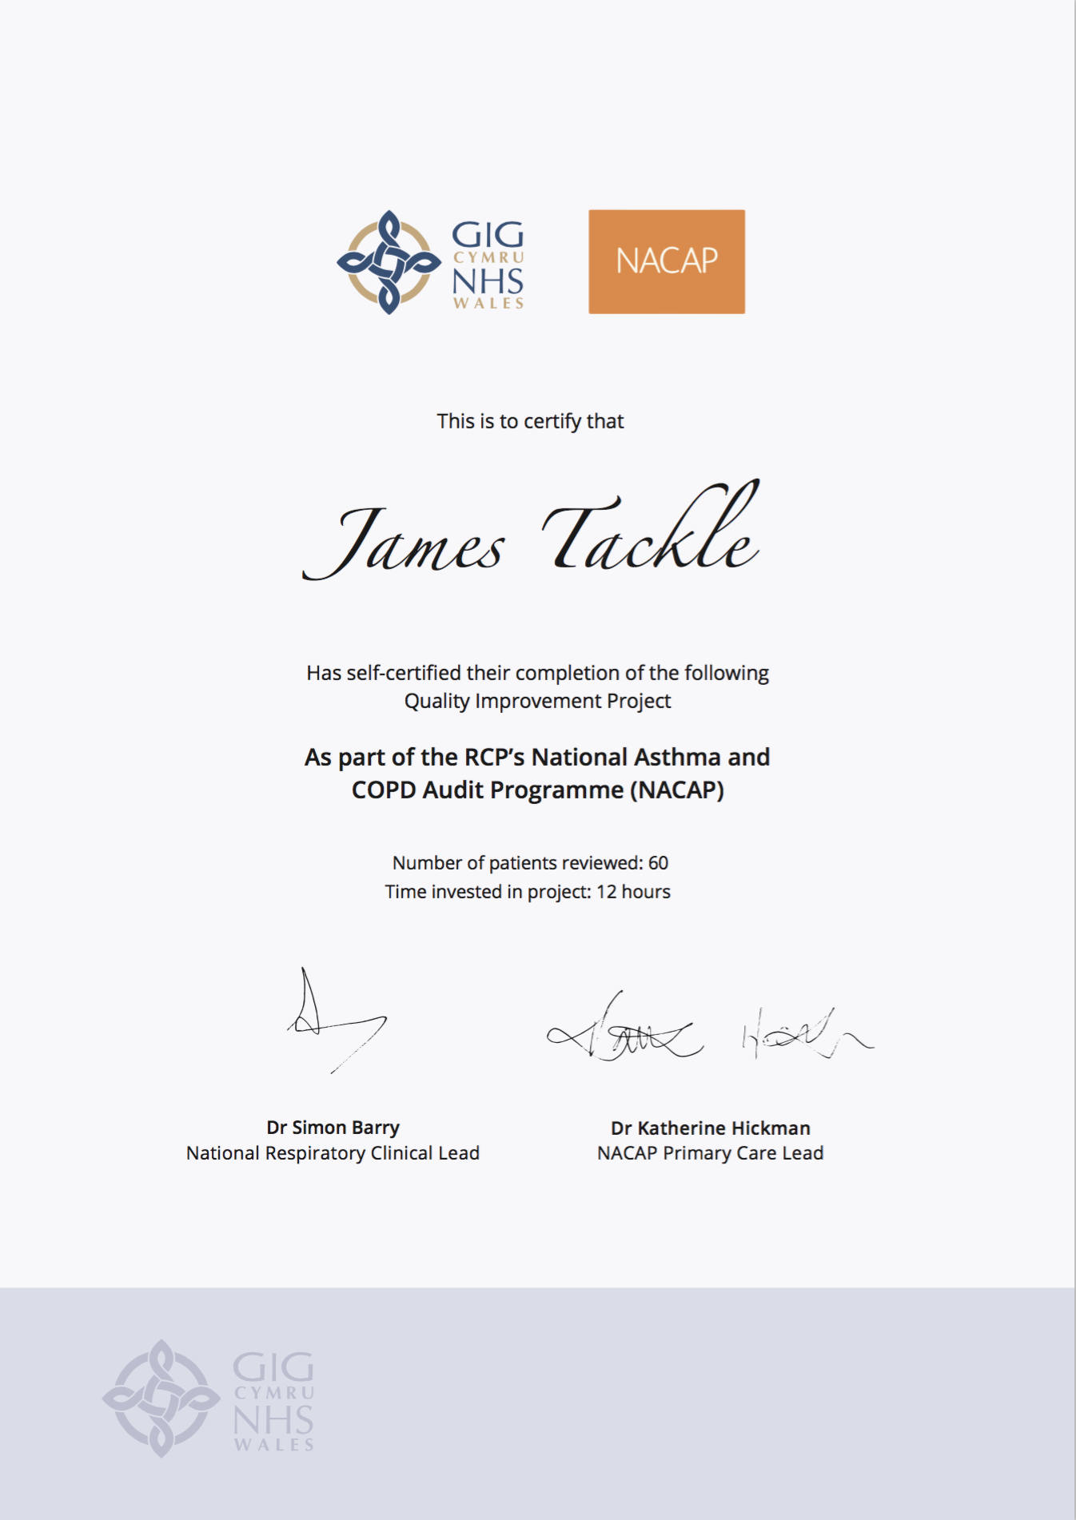
Quality Improvement with ICST
Allowing you to achieve incremental and measurable changes to make a real difference to patients

Slide 3
WHAT IS THE PROBLEM?
Data collected from GP practices across Wales suggest that only 11.5% patients on the COPD registers have evidence of both:
Post-bronchodilator spirometry with FEV1/FVC ratio less than 0.7
AND the correct SNOMED code
and therefore this QI project will ensure that every patient has the correct evidence to support their diagnosis of COPD.

Slide 4
The QI project
Step 1 – Invite patients for a diagnostic review
Invite the following for a review of their COPD diagnosis:
Those who have no record of spirometry
Those who have a record of spirometry which is not post-bronchodilator
Those who have a record of poor quality spirometry
Step 2 – Perform a post-bronchodilator spirometry measurement
Ensure your patient has taken their inhaler at least 20-minutes before testing and perform spirometry.
Step 3 – Check the ratio
Record this results in the patient’s notes with the correct code for post-bronchodilator spirometry.
Step 4 – Confirm or refute the diagnosis
For those patients who now have evidence of a post-bronchodilator spirometry with a FEV1/FVC ratio less than 0.7, confirm the diagnosis and continue managing their COPD.

Slide 5
I propose…
As a practice, we have 350 patients with COPD on our register. I propose we review the diagnosis of 70 of these patients (20%) before July 2021. Each patient review will take 20 minutes.

Slide 6
ANY QUESTIONS?
Getting the diagnosis right for patients on the COPD register
[your name]

