Slide 1
QI Project
Getting the diagnosis right for patients on the Asthma register
[your name]

Slide 2
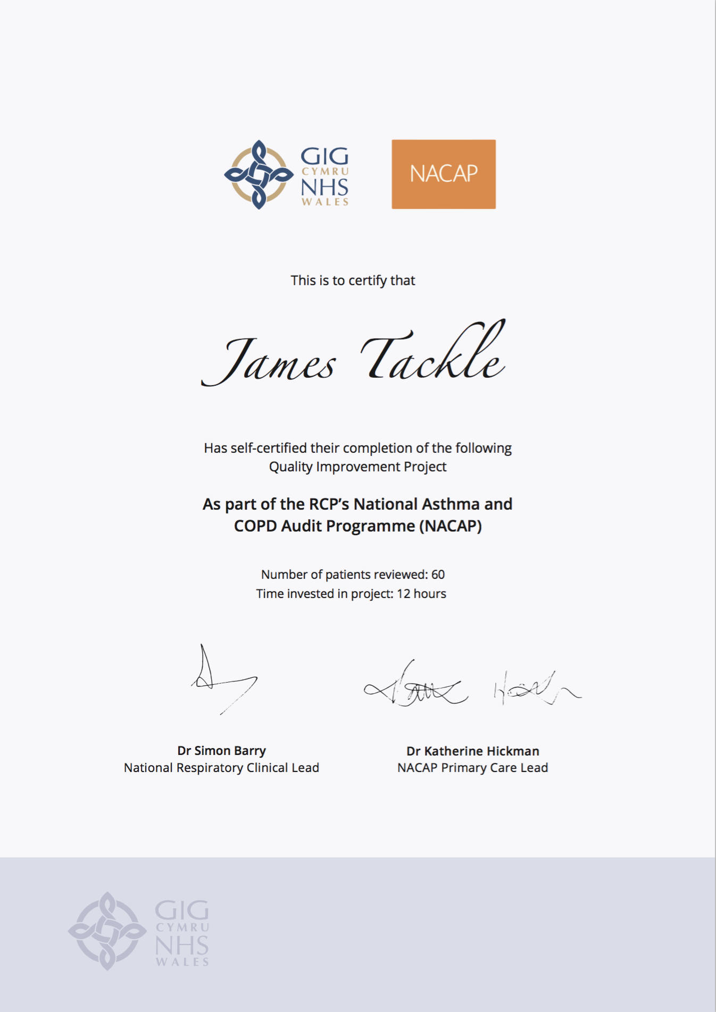
Quality Improvement with ICST
Allowing you to achieve incremental and measurable changes to make a real difference to patients

Slide 3
WHAT IS THE PROBLEM?
Data collected from GP practices across Wales suggest that only 76.3% adult patients and 67.4% children and young people patients on the Asthma registers have evidence of any tests results that can be used to support their diagnosis.
This QI project will ensure that every patient has the correct evidence to support their diagnosis of Asthma.

Slide 4
The QI project – The Asthma Diagnostic Review
Step 1 – Invite patients for a diagnostic review
Gather a list of patients who need a review of their Asthma diagnosis:
Those who have no record of diagnostic testing
Those who have inconclusive test results to support the diagnosis of Asthma
Step 2 – Issue a Peak Flow diary
Ask your patient to complete a two-week peak flow diary.
Step 3 – Check the diary
Once the patient returns the PEF diary, record these results in the patient’s notes with the correct code for a peak flow diary.
Step 4 – Try alternative tests
For those patients who did not experience significant “dips” in their Peak Flow measurement, try an alternative diagnostic test.

Slide 5
I propose…
As a practice, we have 900 patients with Asthma on our register. I propose we review the diagnosis of 100 of these patients before July 2021. Each patient review will take 10 minutes.

Slide 6
ANY QUESTIONS?
Getting the diagnosis right for patients on the Asthma register
[your name]

