Slide 1
QI Project
Getting the diagnosis right for patients on the COPD register
[your name]

Slide 2
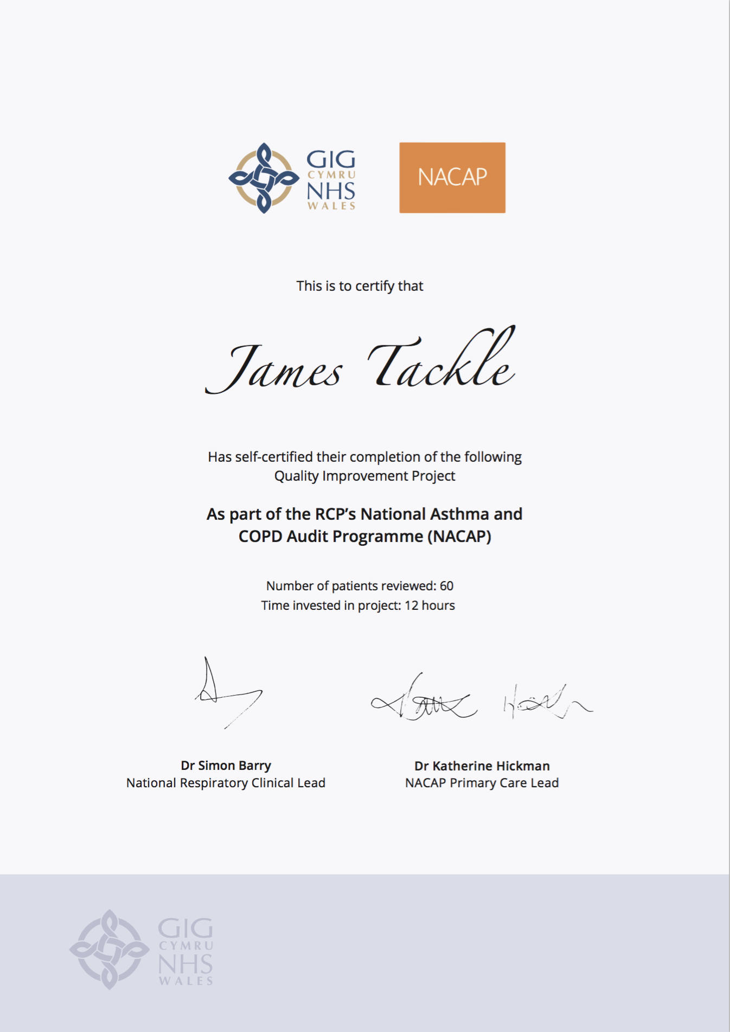
Quality Improvement with ICST
Allowing you to achieve incremental and measurable changes to make a real difference to patients

Slide 3
WHAT IS THE PROBLEM?
Data collected from GP practices across Wales suggest that only 11.5% patients on the COPD registers have evidence of both:
Post-bronchodilator spirometry with FEV1/FVC ratio less than 0.7
AND the correct SNOMED code
and therefore this QI project will ensure that every patient has the correct evidence to support their diagnosis of COPD.

Slide 4
The QI project – fixing the COPD register
Step 1 – Identify your COPD register
Identify every patient on your COPD register.
Step 2 – Sort your patients
Sort your COPD patients by those who have the correct code for post-bronchodilator spirometry.
Step 3 – Check the ratio
Check the patient has the correct FEV1/FVC ratio recorded.
Step 4 – Check the diagnosis
If the FEV1/FVC ratio is greater than 0.7, remove the patient from your COPD register and invite the patient in for a review of their diagnosis
Step 5 – Check for a record of spirometry
For those patients who DO NOT have the correct for post-bronchodilator spirometry, check whether they have ANY record of spirometry.
Step 6 – No record of spirometry
Where there is no evidence of post-bronchodilator spirometry, ensure this patient is invited to perform post-bronchodilator spirometry in their next consultation.

Slide 5
I propose…
As a practice, we have 350 patients with COPD on our register. I propose we review the diagnosis of 100 of these patients before July 2021. Each patient review will take 10 minutes.

Slide 6
ANY QUESTIONS?
Getting the diagnosis right for patients on the COPD register
[your name]

