Slide 1
QI Project
Checking Second Hand Smoke Exposure for Paediatric Asthma patients
[your name]

Slide 2
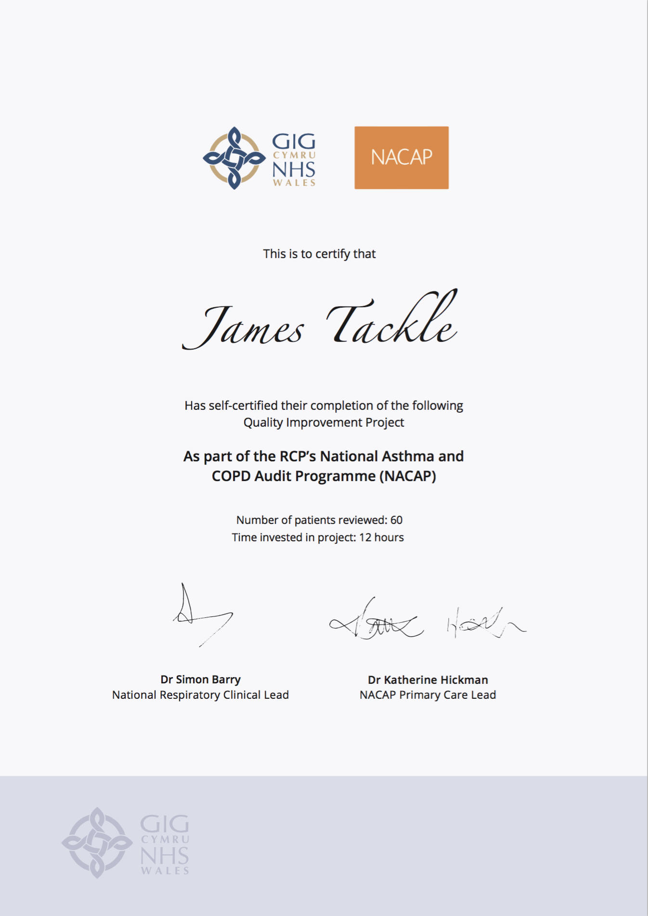
Quality Improvement with ICST
Allowing you to achieve incremental and measurable changes to make a real difference to patients

Slide 3
WHAT IS THE PROBLEM?
Data collected from GP practices across Wales suggest that less than 1% patients on the paediatric asthma registers have been asked about their exposure to second hand smoke and their parent’s offered Very Brief Advice.
This QI project will ensure that these conversations are happening during every Paediatric Asthma Review, and these conversations are being coded.

Slide 4
The QI project – Ask patients about second-hand smoke exposure and offer Very Brief Advice
Step 1 – Update the Asthma Review templates
Update the templates that inform a Paediatric Asthma Annual Review, ensuring that the following actions are made for every patient:
The patient is asked about their exposure to second hand smoke
If the parent/ carer of a child with asthma smokes, that caregiver is offered some very brief advice (VBA)
Step 2 – During the Asthma Review
For every paediatric asthma patient who attends a review of their asthma, ask whether they are being exposed to second hand smoke and code accordingly.
Step 3 – Offer Very Brief Advice (VBA)
If the child is being exposed to second hand smoke or are at risk of exposure, the caregiver should be offered some very brief advice and/or referred for smoking cessation, and this should also be coded.

Slide 5
I propose…
As a practice, we have 400 paediatric patients with Asthma on our register. I propose we review 100 of these patients and update their records on second hand smoke exposure before July 2021. Each patient review will take 15 minutes.

Slide 6
ANY QUESTIONS?
Checking Second Hand Smoke Exposure for Paediatric Asthma patients
[your name]

