Slide 1
QI Project
Providing High-Value Care - Promote the COPDhub App
[your name]

Slide 2
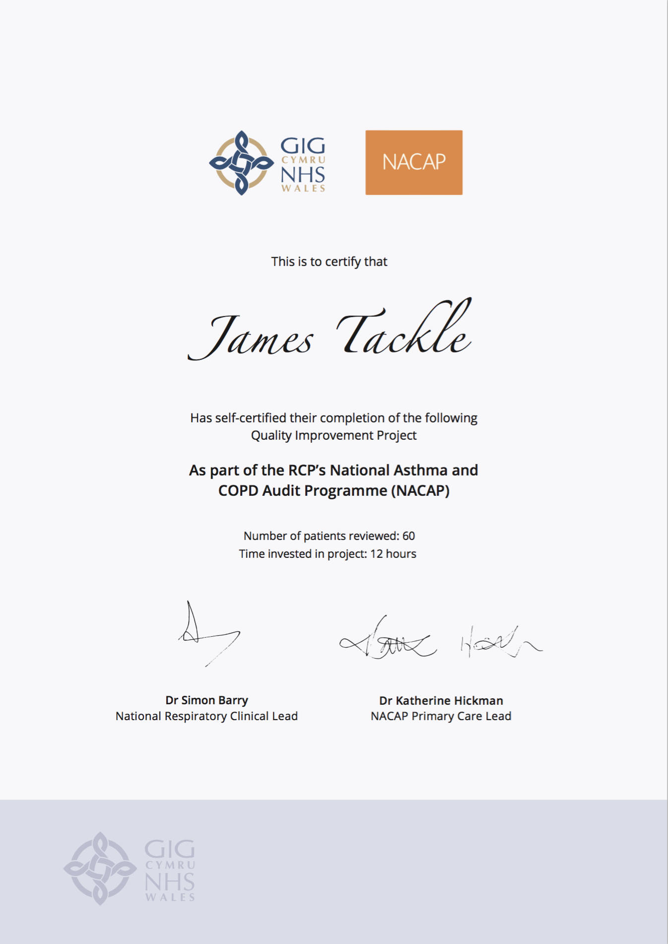
Quality Improvement with ICST
Allowing you to achieve incremental and measurable changes to make a real difference to patients

Slide 3
WHAT IS THE PROBLEM?
Data collected from GP practices across Wales suggest that only 56% of people with COPD have been referred for pulmonary rehabilitation. Pulmonary rehabilitation is one of the highest value interventions for patients with COPD; on completion of a PR programme, a high proportion of patients achieve important gains in exercise performance and/or health status.
This QI project will ensure that more patients are offered this high value intervention, and those who do not meet the criteria for pulmonary rehabilitation are advised to use the COPDhub app which contains a lot of valuable resources for patients with COPD.

Slide 4
The QI project – Ask patients about second-hand smoke exposure and offer Very Brief Advice
Step 1 – Identify your COPD register
Identify every patient on your COPD register.
The recommended codes for the diagnosis of COPD is:
Read code: H3…00
SNOMED code: 13645005
Step 2 – Promote the app
Using text messages, emails or printed leaflets (linked in the resources section) ensure the population of patients with COPD on your registers are aware of the COPDhub app as a mechanism for learning more about their COPD, checking their inhaler technique, monitoring their symptoms for signs of deterioration and a supplementary exercise programme that they can try at home.

Slide 5
I propose…
As a practice, we have 400 COPD patients on our register. I propose we encourage every patient to download the NHS Wales COPDhub app which provides patients with a virtual pulmonary rehabilitation programme.

Slide 6
ANY QUESTIONS?
Providing High-Value Care - Promote the COPDhub App
[your name]

