Slide 1
QI Project
Providing High-Value Care – Referral to Pulmonary Rehabilitation
[your name]

Slide 2
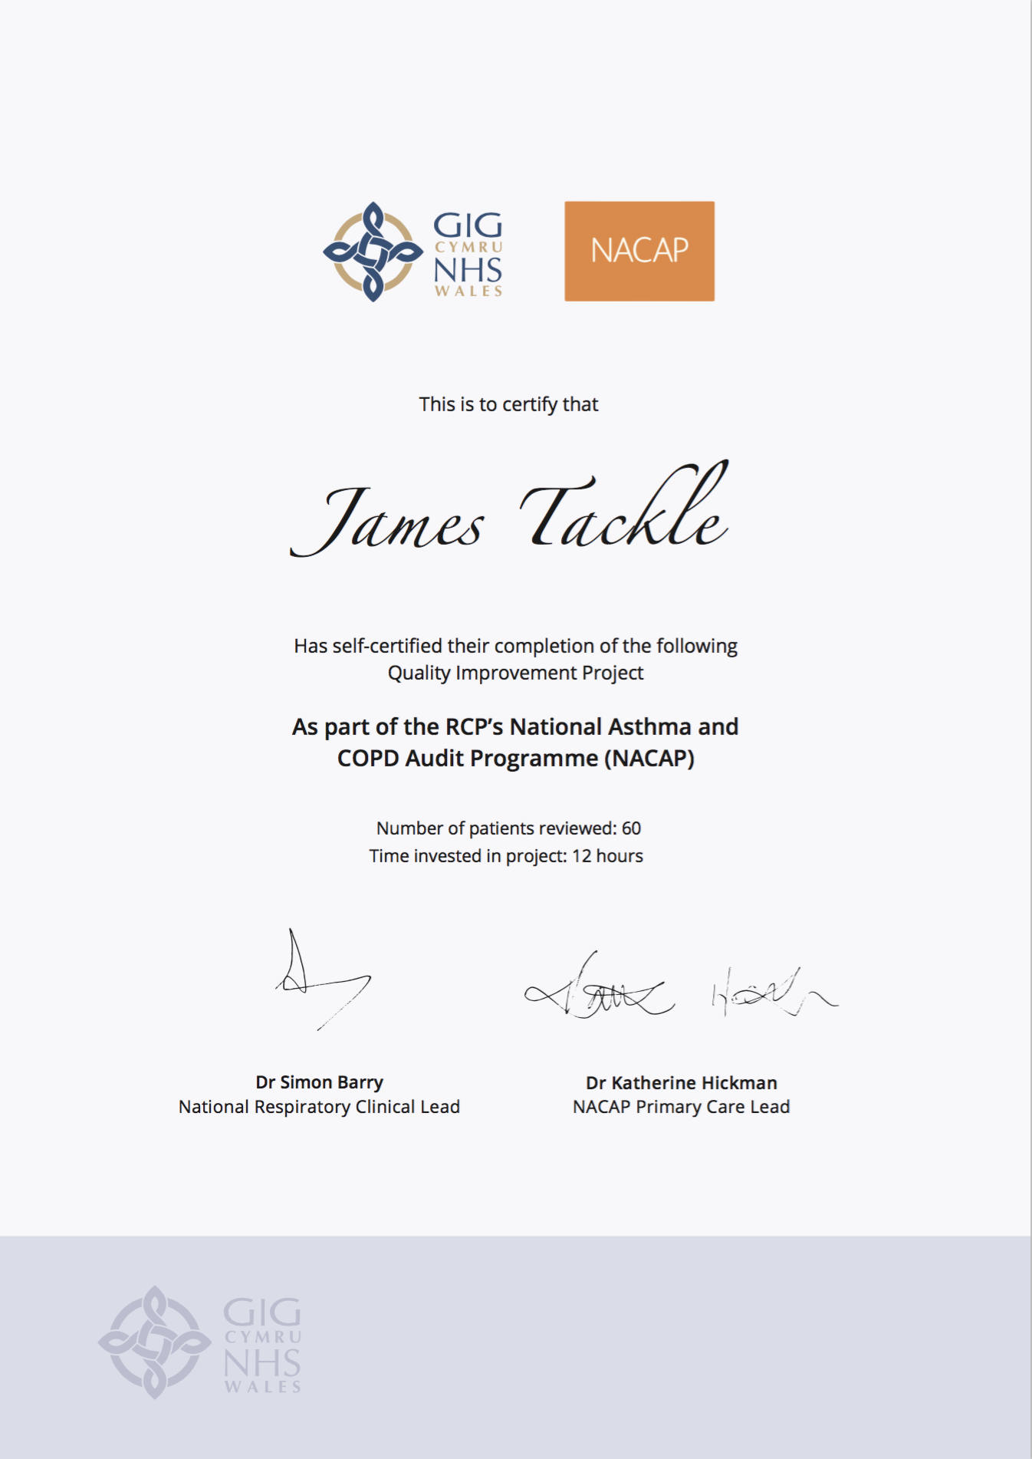
Quality Improvement with ICST
Allowing you to achieve incremental and measurable changes to make a real difference to patients

Slide 3
WHAT IS THE PROBLEM?
Data collected from GP practices across Wales suggest that only 56% of people with COPD have been referred for pulmonary rehabilitation. Pulmonary rehabilitation is one of the highest value interventions for patients with COPD; on completion of a PR programme, a high proportion of patients achieve important gains in exercise performance and/or health status.
This QI project will ensure that more patients are offered this high value intervention.

Slide 4
The QI project – Ask patients about second-hand smoke exposure and offer Very Brief Advice
Step 1 – During a patient review check the patient’s MRC score
During a routine COPD review, check the patient’s MRC score:
Not troubled by breathless except on strenuous exercise
Short of breath when hurrying on a level or when walking up a slight hill
Walks slower than most people on the level, stops after a mile or so, or stops after 15 minutes walking at own pace
Stops for breath after walking 100 yards, or after a few minutes on level ground
Too breathless to leave the house, or breathless when dressing/undressing
Code the patient’s MRC score appropriately
Step 2 – Referral to Pulmonary Rehabilitation
Identify any patients who are functionally disabled by their breathlessness, i.e. they have a Medical Research Council Dyspnoea Score between 3 and 5.
For those patients who have a MRC score between 3 and 5, discuss referral to Pulmonary Rehabilitation.

Slide 5
I propose…
As a practice, we have 400 COPD patients on our register. I propose we review the MRC score for 30 of these patients and make a referral to pulmonary rehabilitation programme for those who are eligible.

Slide 6
ANY QUESTIONS?
Providing High-Value Care – Referral to Pulmonary Rehabilitation
[your name]

