Slide 1
QI Project
Personalised Asthma Action Plan– Promote Asthmahub apps
[your name]

Slide 2
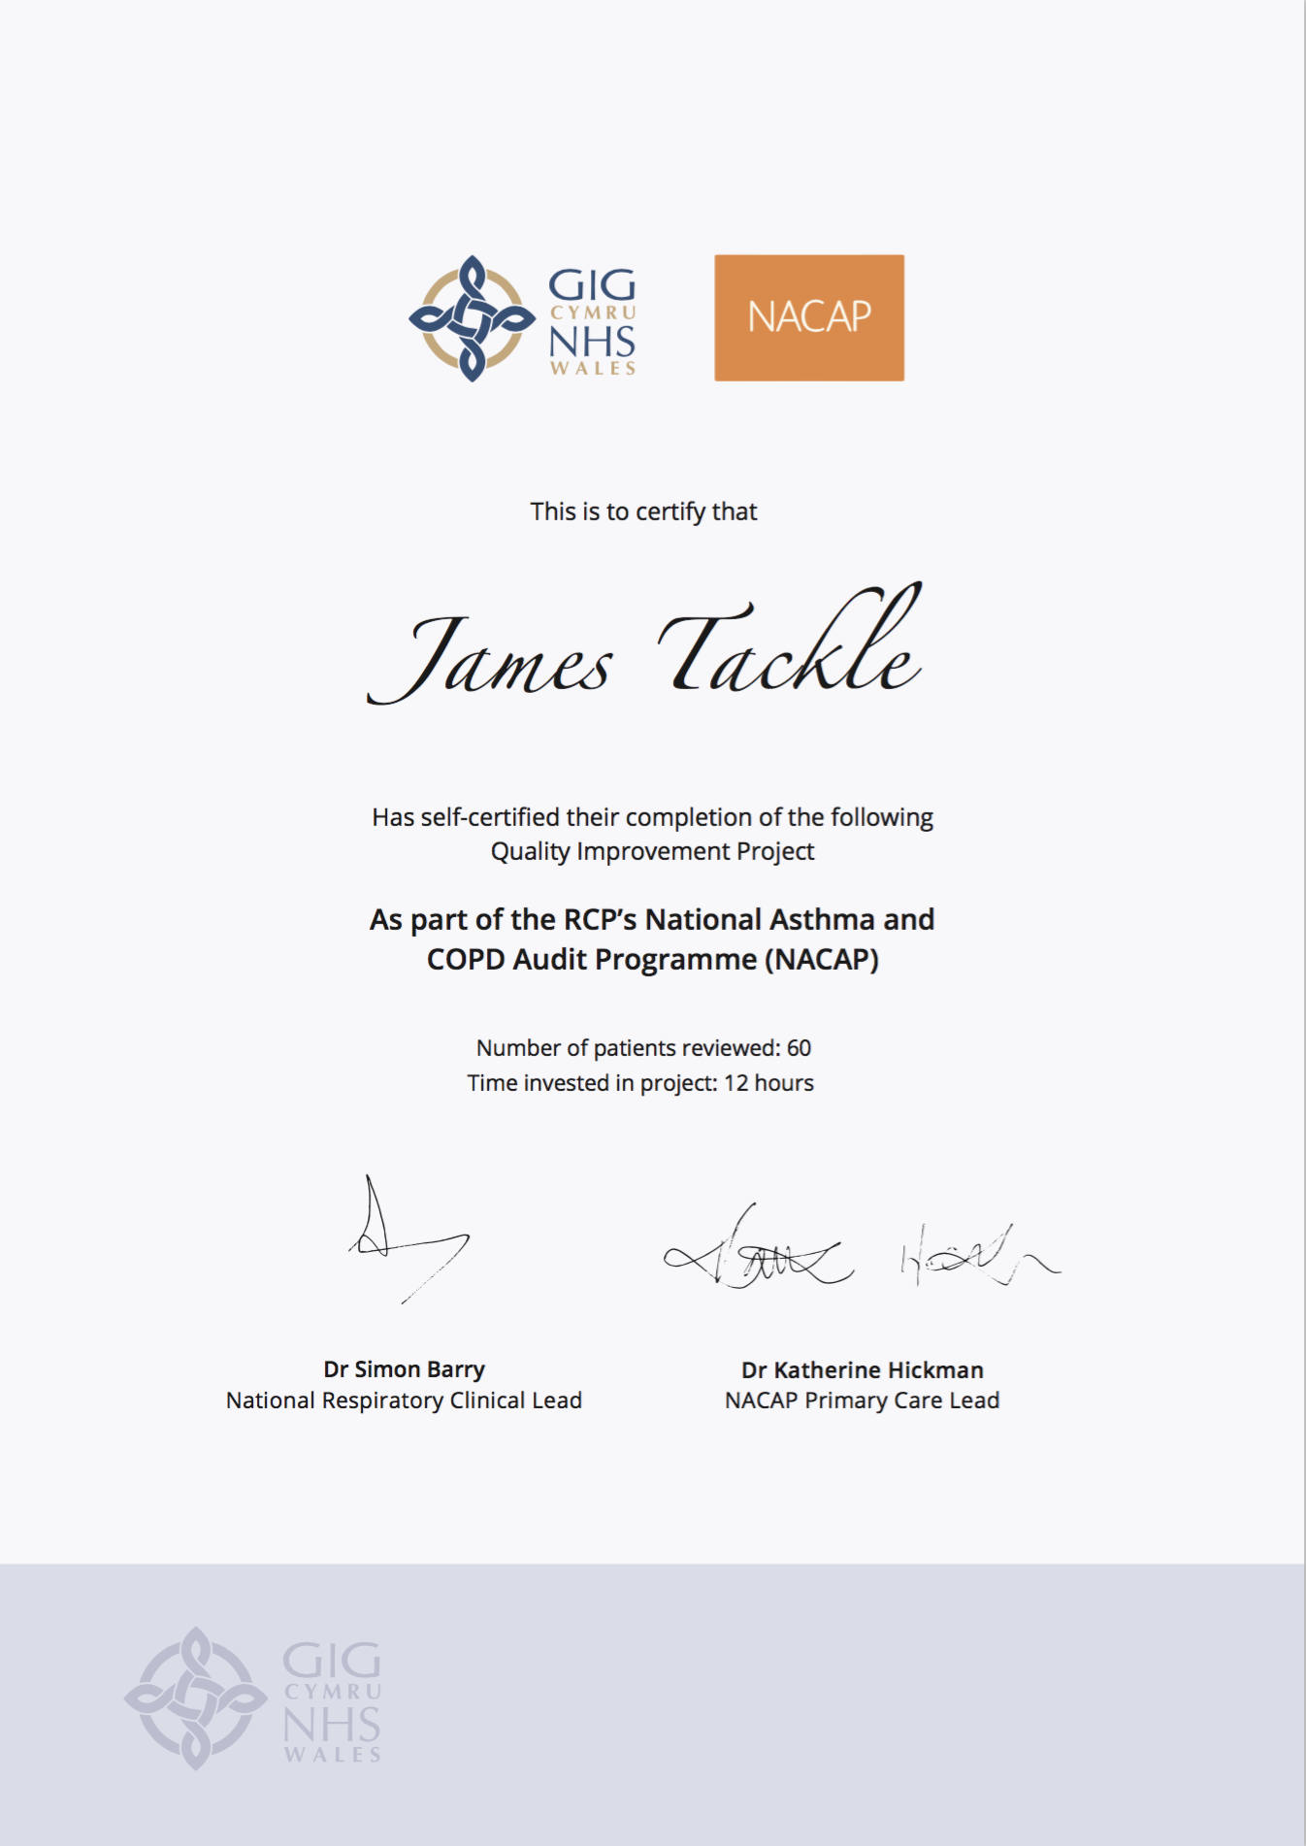
Quality Improvement with ICST
Allowing you to achieve incremental and measurable changes to make a real difference to patients

Slide 3
WHAT IS THE PROBLEM?
Data collected from GP practices across Wales suggest that less than one in four patients with asthma have any record of a personalised Asthma Action Plan in their records. It is widely acknowledged that without a personalised asthma action plan, patients are four times more likely to be admitted to hospital with an exacerbation of their asthma.
This QI project will ensure that every patient on the Asthma register has access to a Personalised Asthma Action Plan.

Slide 4
The QI project – Ask patients about second-hand smoke exposure and offer Very Brief Advice
Step 1 – Identify your Asthma register
Identify every patient on your Asthma register.
Step 2 – Promote the apps
Using text messages, emails or printed leaflets to ensure the population of patients with Asthma on your registers are aware of the Asthmahub and Asthmahub for parents app. The apps provide patients with a virtual Personalised Asthma Action Plan, as well as loads of really useful advice on staying well, using their inhalers, monitoring their peak flow and symptoms, and knowing what to do when their symptoms deteriorate.

Slide 5
I propose…
As a practice, we have 800 Asthma patients on our register. I propose we encourage every patient to download the NHS Wales Asthmahub and Asthmahub for parents apps which provides patients with a virtual personalised asthma action plan.

Slide 6
ANY QUESTIONS?
Personalised Asthma Action Plan– Promote Asthmahub apps
[your name]

