Slide 1
QI Project
Personalised Asthma Action Plan– The Asthma Annual Review
[your name]

Slide 2
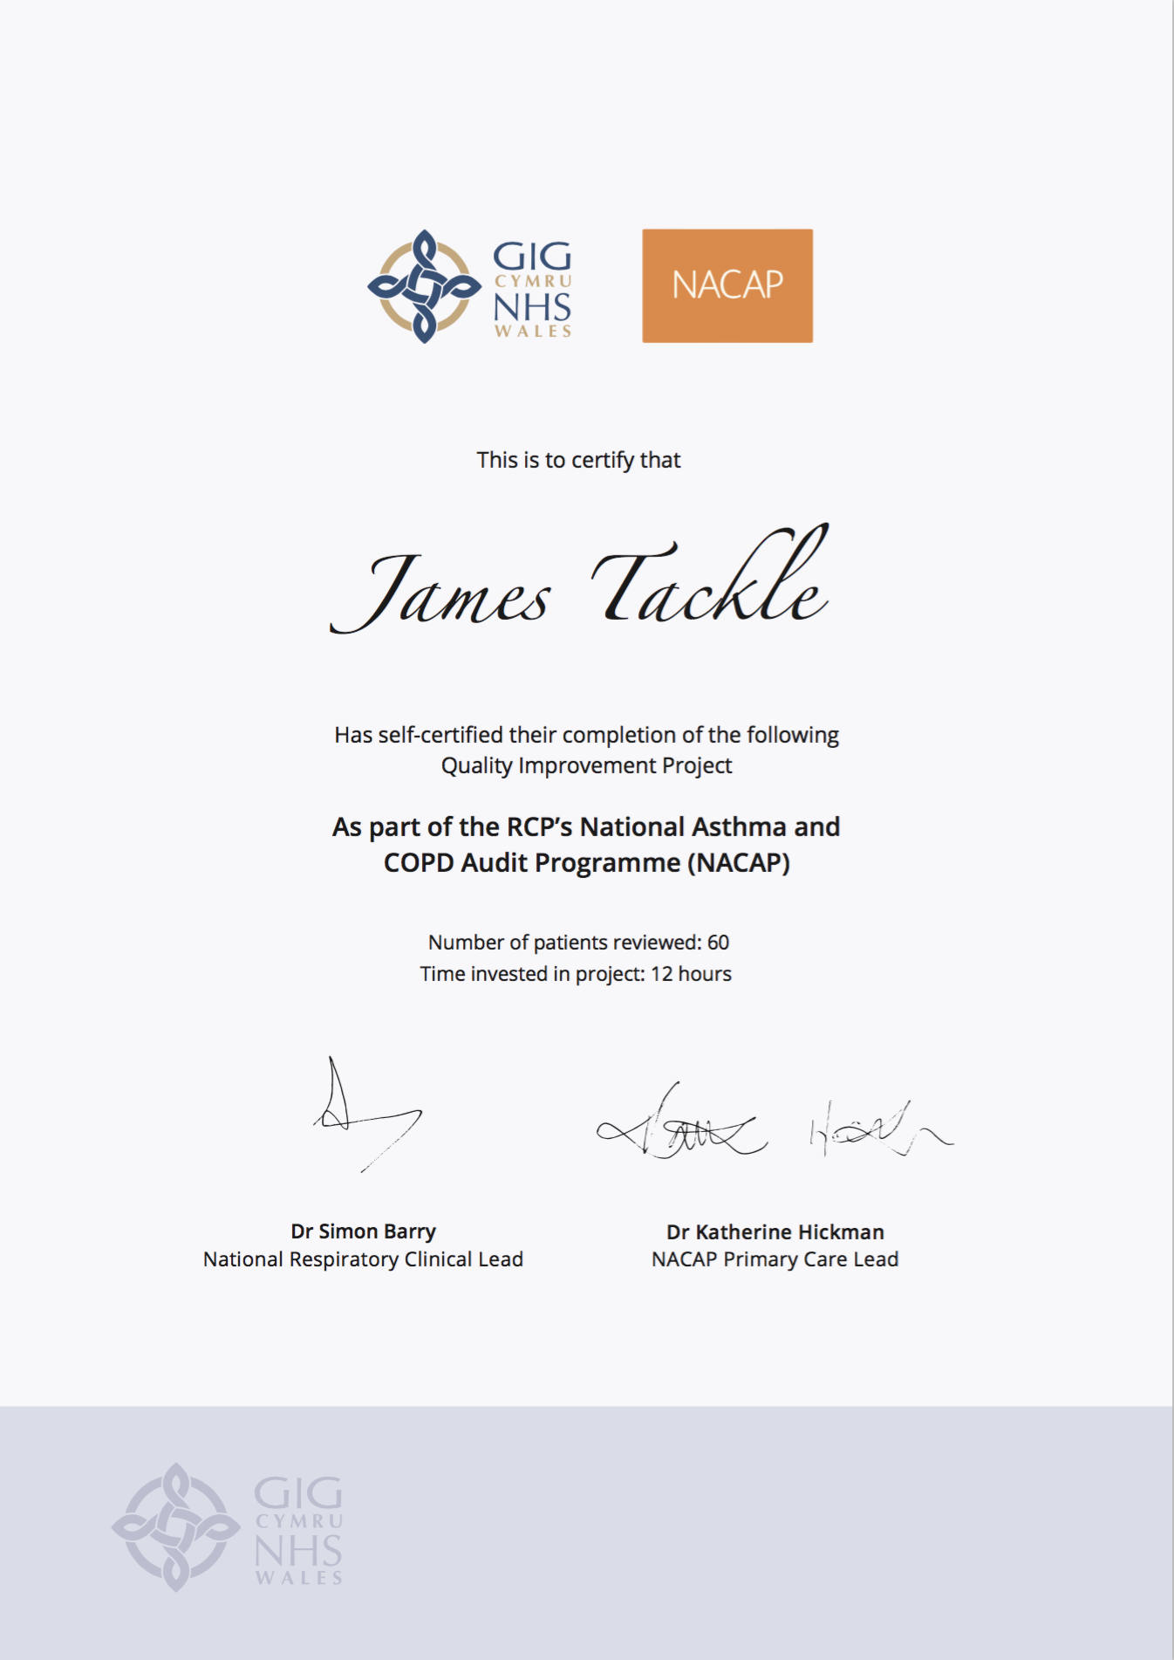
Quality Improvement with ICST
Allowing you to achieve incremental and measurable changes to make a real difference to patients

Slide 3
WHAT IS THE PROBLEM?
Data collected from GP practices across Wales suggest that less than one in four patients with asthma have any record of a personalised Asthma Action Plan in their records. It is widely acknowledged that without a personalised asthma action plan, patients are four times more likely to be admitted to hospital with an exacerbation of their asthma.
This QI project will ensure that every patient on the Asthma register has access to a Personalised Asthma Action Plan.

Slide 4
The QI project – Ask patients about second-hand smoke exposure and offer Very Brief Advice
Step 1 – During a patient review
During a routine Asthma review, identify any patients who do not have a Personalised Asthma Action Plan (PAAP) and determine which of the following they would prefer:
A paper PAAP
The Asthmahub or Asthmahub for parents app, that provides them with a virtual Personalised Asthma Action Plan, as well as loads of really useful advice on staying well, using their inhalers, monitoring their peak flow and symptoms, and knowing what to do when their symptoms deteriorate.
During an Asthma review, ensure they have an up-to-date Personalised Asthma Action Plan and the patient knows how to use it.
Step 2 – Code the PAAP
Code the patient’s Personalised Asthma Action Plan in their notes.

Slide 5
I propose…
As a practice, we have 800 Asthma patients on our register. I propose we review the personalised asthma action plan of 40 patients and make sure it’s up to date.

Slide 6
ANY QUESTIONS?
Personalised Asthma Action Plan– The Asthma Annual Review
[your name]

