Slide 1
QI Project
Inhaler Technique Check – Promote the Healthhub apps
[your name]

Slide 2
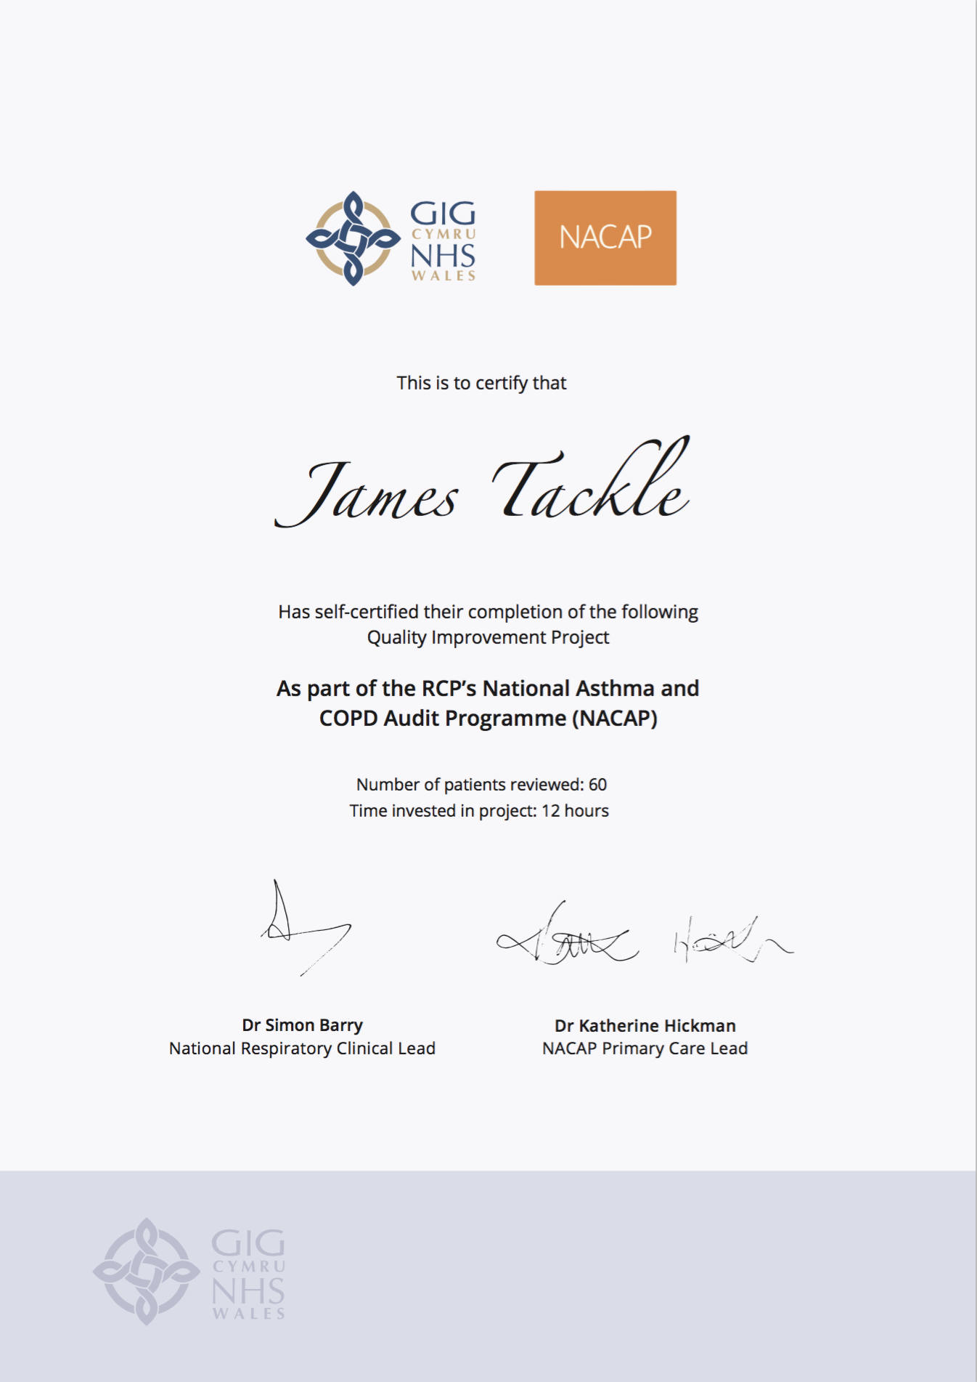
Quality Improvement with ICST
Allowing you to achieve incremental and measurable changes to make a real difference to patients

Slide 3
WHAT IS THE PROBLEM?
Data collected from GP practices across Wales suggest that only 44.4% patients on the COPD and Asthma registers have had their inhaler technique checked.
This QI project will ensure that every patient on the Asthma and COPD registers know how to take their inhalers with good technique, and know where to access videos for a refresher of the correct inhaler technique.

Slide 4
The QI project – Ask patients about second-hand smoke exposure and offer Very Brief Advice
Step 1 – Identify your Asthma and COPD registers
Identify every patient on your Asthma and COPD registers.
Step 2 – Promote the apps
Using text messages, emails or printed leaflets to ensure the population of patients with Asthma and COPD on your registers are aware of the Healthhub apps as a mechanism for learning more about their lung condition, checking their inhaler technique, monitoring their symptoms for signs of deterioration and a supplementary exercise programme that they can try at home.

Slide 5
I propose…
As a practice, we have 400 COPD patients and 800 Asthma patients on our register. I propose we encourage every patient to download the NHS Wales Healthhub apps which contains inhaler technique videos.

Slide 6
ANY QUESTIONS?
Inhaler Technique Check – Promote the Healthhub apps
[your name]

