Slide 1
QI Project
Inhaler Technique Check – The Asthma and COPD Annual Review
[your name]

Slide 2
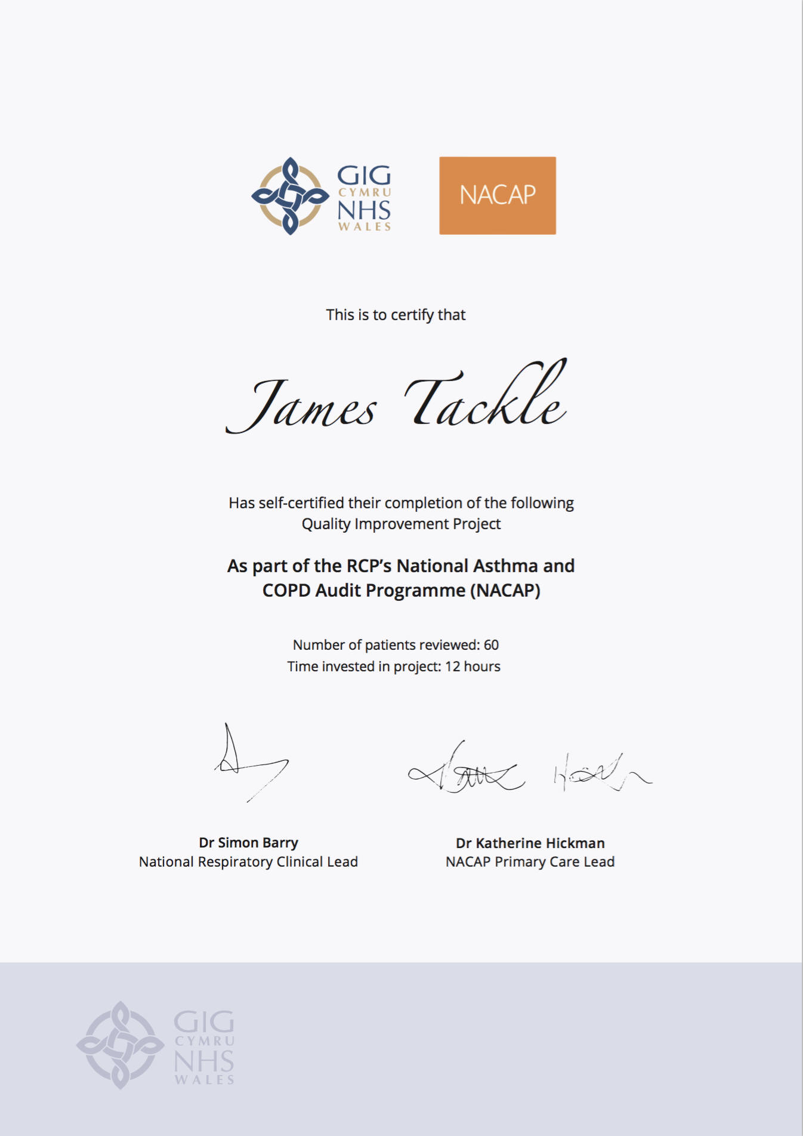
Quality Improvement with ICST
Allowing you to achieve incremental and measurable changes to make a real difference to patients

Slide 3
WHAT IS THE PROBLEM?
Data collected from GP practices across Wales suggest that only 44.4% patients on the COPD and Asthma registers have had their inhaler technique checked.
This QI project will ensure that every patient on the Asthma and COPD registers know how to take their inhalers with good technique, and know where to access videos for a refresher of the correct inhaler technique.

Slide 4
The QI project – Ask patients about second-hand smoke exposure and offer Very Brief Advice
Step 1 – During a patient review
During a routine Asthma or COPD review, check the patient’s inhaler technique. Ensure the patient is also signposted to videos that demonstrate the correct inhaler technique, if they need a reminder after their review, including those on the Healthhub apps.
Step 2 – Code the Inhaler Technique Check
Code that the patient’s inhaler technique has been observed

Slide 5
I propose…
As a practice, we have 400 COPD patients and 800 Asthma patients on our register. I propose we check the inhaler technique of 60 patients before July 2021, and ensure each patient is signposted to videos that demonstrate the correct inhaler technique.

Slide 6
ANY QUESTIONS?
Inhaler Technique Check – The Asthma and COPD Annual Review
[your name]

