Slide 1


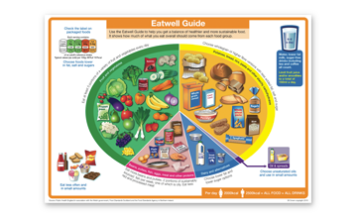
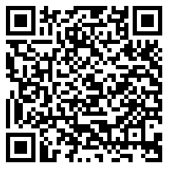

Getting Better After Illness:
Food and Nutrition
You may have eaten more or less than normal when ill, and you may have noticed after being unwell that your weight has gone up and down. You may be wanting to eat more or less than you did before you were ill.
While this can be worrying, it is important to remember that this is completely normal, it happens to lots of us when we have been ill.
Eating and drinking is something you can do to help your body have the energy it needs to get better so you can do all the things that matter to you.
Try to drink and eat a balanced diet. If you do this, your body has all the energy it needs to get better, and you may get better faster!
Have a look at our Eat Well Guide for more information on a balanced diet!

Slide 2



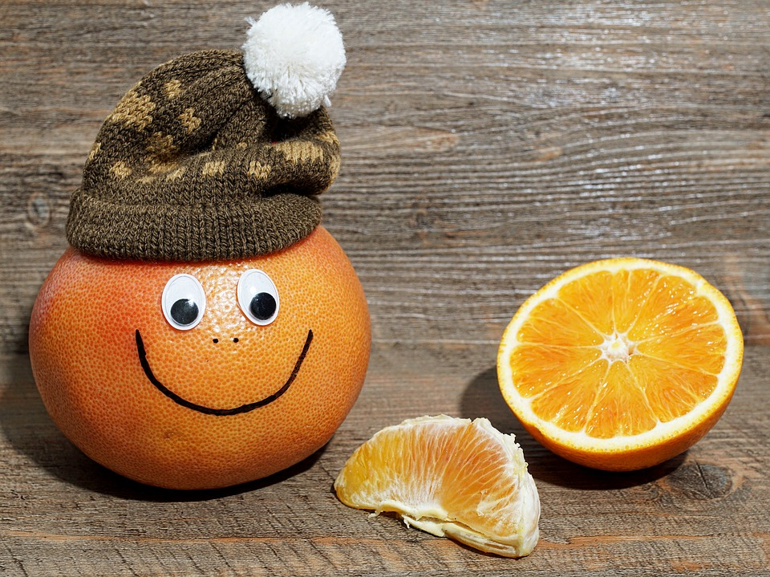
When you are feeling ill and sick, you may not feel like eating.
If you do have a low appetite, it might be helpful to try eating little and often
Sometimes if your mouth is sore, it can be helpful to eat soft foods
Talk to your family. If you aren’t feeling like eating your family might have some good ideas to help.
Ask for your favourite foods to help you to feel like eating.
When we have been unwell, the temperature, taste and smell of foods might seem different. They might seem more or less tasty than normal. It can take time for the taste to come back.
It might be a fun idea to be playful and experiment with food. Make a game out of it e.g. guess the food with your eyes shut or play carrot and pea snooker!
If you are living with a medical condition, it might be a good idea to let your medical team know that you have been poorly, as they may be able to support you with this
If you are struggling to eat big meals, choose high calorie foods like toast, peanut butter and flapjack
Drinking lots of fluids is really important to help your body to fight infection. Try drinking water or sugar-free squash.
Sitting up while eating and drinking is really good for digestion and can help with feeling sick.

Slide 3

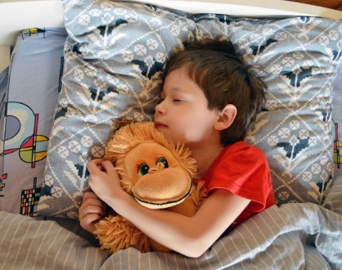
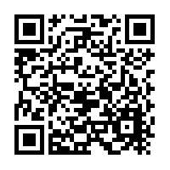

Getting Better After Illness:
Sleep
Sleep and rest are really important to help your body get better when you are ill and afterwards too!
This means that your sleeping routine often turns upside down, because you feel really tired all the time and may sleep during the day and then not be able to sleep at night.
This can be frustrating when you are starting to feel better and you are still finding it difficult to sleep at night. It is important to know that this is normal and it happens to everyone.
Try to be mindful of how many naps you might be having in a day. If we nap too much, we are less likely to be sleepy when it comes to bed time. We recommend no naps after 3pm, as this can stop you sleeping at night. A nap should not last longer than 30 minutes, and should be in a well lit room.
If you are feeling really tired during the day, try to add an extra hour of sleep each night until you feel recovered.
If you can, it is important to try and sleep at night. Night-time sleep helps our body the most to recover. That's why we sleep at night!
Have a look at this Sleep Time Guide for some more tips on the ideal amount of sleep

Slide 4

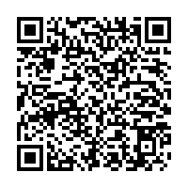


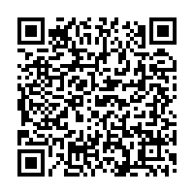
Try to stick to the same bedtime and wake time every day, even on weekends. This is really important in helping set our body clock, and will also help with feeling better after being poorly.
Quiet, calm, and relaxing activities. It is a good idea to avoid loud and exciting activities before bed, because this will make your body think it isn’t bedtime. We have some handy relaxing breathing activities that can help you relax before bedtime.
Cuddle up with a stuffed animal or soft blanket. Cuddling something you love can help you to feel calm, relaxed and safe, and might help you get to sleep quicker too.
Remember, beds are for sleeping. Try not to do homework or watch TV while you are in bed. By using your bed just for sleeping, your brain will learn that you need to go to sleep when you are in bed, and you might fall asleep quicker
Create a bedtime routine. It can be a good idea to have a bedtime routine, a set of things you do every night before going to bed. This will help to remind your brain and body that it is bedtime, and you might be able to fall asleep quicker
Have a look at this Sleep Well Guide for some more tips on how to improve sleep!

Slide 5

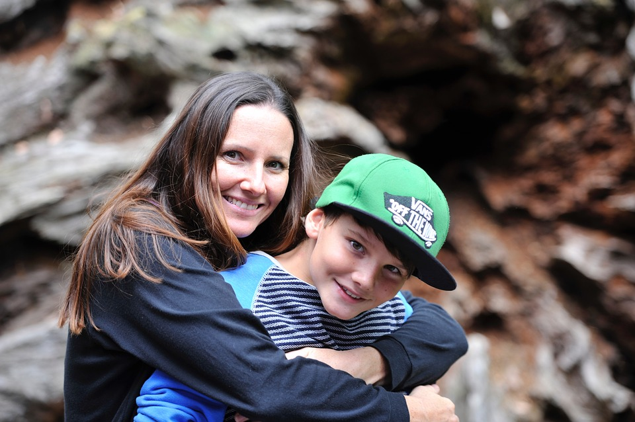
Getting Better After Illness:
Coping with Difficult Thoughts and Feelings
When you are or have been poorly, you can still be really worn out, and this can affect your feelings too; you may feel sad, tired, frustrated or scared.
When you are ill you might have lots of difficult thoughts as well. These thoughts are trying to tell us important information about something that matters to you e.g. thoughts about getting better or missing out on being with your friends.
Sometimes, thoughts can be really scary. It is important to try and remember that you aren’t alone and people can help if you let them know.
As you start to recover from your illness and start to do more of the things you love, you might notice that these thoughts get in the way less.
If overwhelming thoughts and feelings keep popping up, it’s important to talk to a trusted adult.
If it’s a helpful thought, you can work together to find out the answer, but if it’s an unhelpful thought then there are lots things you can do to look after yourself
Sometimes these thoughts can be really tricky, but there are some things you can do to help.

Slide 6
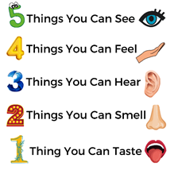
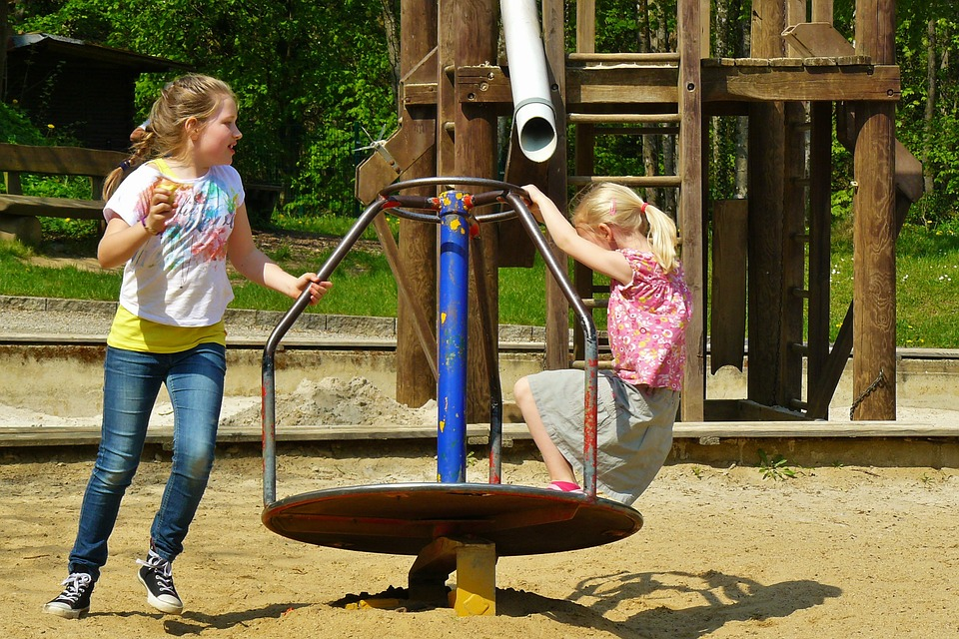
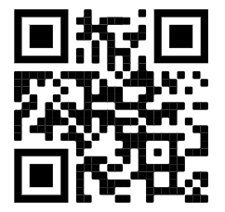
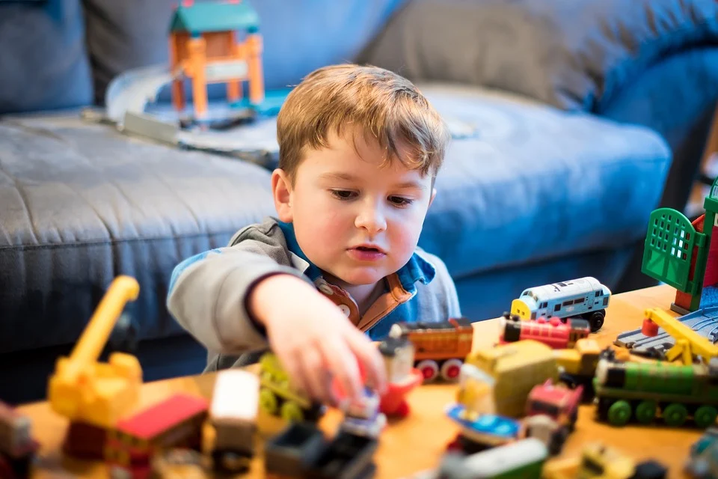
Try some grounding exercises – try to pay attention to your senses, think about what you can see, smell, touch, taste and hear.
Reach out to friends – our friends can be really good when we are feeling overwhelmed. Sometimes all we want to do is be alone, but it is important to try and reach out and be with other people.
Try to do some things you enjoy or that matter to you – this could be reading, art, sports or anything else! This can be difficult when your mind is telling you that “I am too tired”. It is trying to be helpful but it is stopping you doing things that may help you feel more like you.
Try being active, doing exercise – sometimes this can be difficult to do, so try not to force yourself to do a lot straight away. You could try going on a short walk, with your friend or family.
Self-care is really important, and it is different for everyone. It could be taking a bubble bath, playing your favourite game, going on a nice walk with your family, or having a movie night. Self-care is all about what makes you feel better.
Checking in with school and other professionals who can give you more specialist support if you need it. There are always adults around you who want to help you. If you are finding things really hard, you can go to your GP (your doctor!) for help and support.
Have a look at the YoungMinds website for some tips for when you are experiencing overwhelming thoughts.
https://youngminds.org.uk/

Slide 7



Getting Better After Illness:
Brain Fog, Memory and Concentration
When you have been unwell you might have something called ‘brain fog’. This might feel like a fuzzy head.
On some days you may feel ok, but the next day might feel really hard and like your brain just won’t work.
Remember, brain fog will get better over time for most people. If you feel like your brain fog isn’t going away or is making it really difficult to do every day activities, you should tell an adult you trust who can help you.
Lots of people struggle with brain fog after being ill.
Brain fog can mean difficulty with things like;
paying attention
remembering things, and
concentration.
You might find it hard to do school work, read a book, or remember things you need to do.
You might notice that you:
Feel tired
Can’t think clearly
Have a headache

Slide 8


There are things you can do to help when you are feeling like you have brain fog.
Some of them mean taking extra effort to do all of the things we usually do to look after ourselves like:
Here are some more practical tricks that you could try when you have brain fog. There tools help with things like memory and concentration. You might have apps on a phone or iPad that can help!
Plan a routine so your brain doesn’t always have to think what you are doing next
Write lists and reminders
Use timers and alarms
Do one thing at a time
Be organised
Go to a quiet place and remove extra stimulation (like lights and noise)
Sleeping as well as you can at night
Eating a balanced diet
Making sure you have had enough to drink
Do some physical exercise in short bursts of 6-8 minutes
If you notice your brain being foggy it’s a big clue to take a rest.
It’s important for adults around you to know when you have brain fog so that they can help you do all of these things.

Slide 9
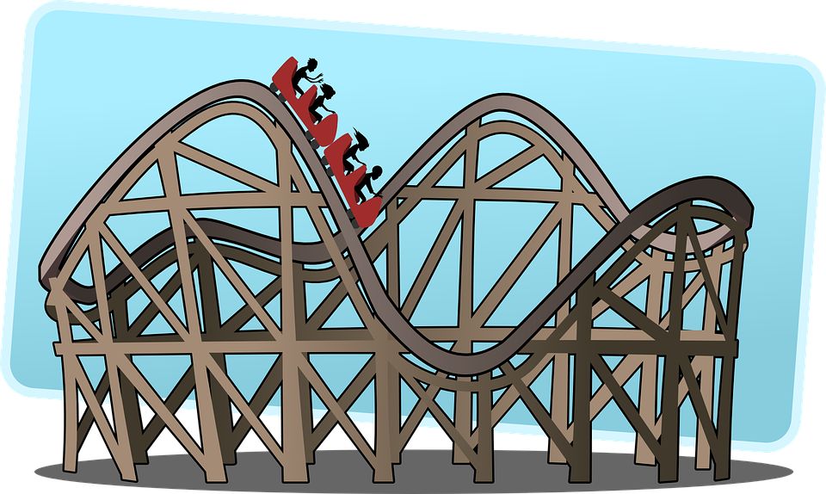


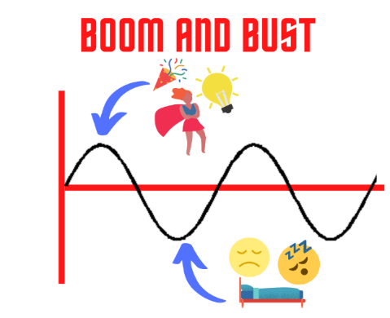

Getting Better After Illness:
Fatigue and Tiredness
After you have been ill you might notice that you still get very tired quickly. You might feel tired all of the time.
You can think of our energy levels like a battery. It is a certain size, and needs charging now and again. When we have been unwell, our battery shrinks in size, it takes longer to charge, and it uses up energy more quickly.
When we talk about feeling tired, we are thinking about energy levels and how much activity we can do. Activity does not just mean exercise. It can mean having a shower, watching TV, doing school work, or talking to someone on the phone.
It can feel easier to do nothing when we are very tired, and do everything when we have a good day. This means that your energy levels are always going up and down like a rollercoaster!
A good way to manage fatigue is to do ‘little and often’. This means when you are feeling at your worst, trying to do some activity, and when you’re feeling your best, doing some activity, but not using all of the energy up in your battery.
This means your energy levels stay a lot more stable and flat – like a train! You then know what energy that you have to use everyday and can plan.
Images taken from ME/CFS Archives | Life changes with me

Slide 10
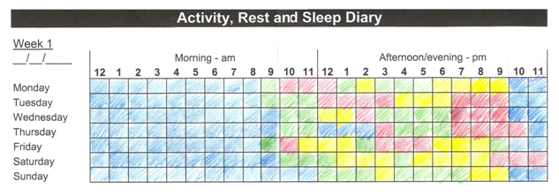
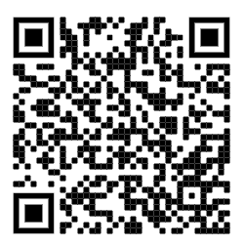
A good way to help manage fatigue is to plan an activity diary. We can do this by spreading your activities throughout the day.
Here are some examples of different levels of activity:
Red – High energy activities (school work, exercise)
Yellow – Medium energy activities (having a shower, making breakfast, talking to a friend, playing a game)
Green – Low energy activities (watching TV, having a bubble bath)
Blue – Sleeping or resting
Planning and prioritising what you need to do in a day can help the fatigue and tiredness feel more manageable.
Be kind to yourself. When you are working with less energy, it makes sense that you wouldn’t be able to get all of the things done that you used to do.
Your weekly diary might end up looking something like this.
You should have lots of green and red squares mixed next door to each other, rather than a big chunk of green or big chunk of red – remember, it is really important to spread your activities out, as this will help you to manage your fatigue.
It’s important to show your diary to school or college so that they can help you plan green times in your day, which might usually be full of red.
There are more great resources here
which you can show to your parent or carer!

Slide 11

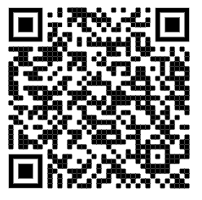

Getting Better After Illness:
Helping with Pain
Pain is our body’s way telling us we need to look after ourselves and tell someone this is happening.
Pain can be fast and sharp, or it can last for a long time and be more dull.
There are lots of reasons you might feel pain after an illness. You might have a sore throat or feel aches and pains in your muscles. Make a note or a diary of the when you are in pain and how you are feeling.
If the pain is new, you could rate the pain out of 10. Showing this to adults around you will help them to understand what is going on.
When you have been ill, it can take time for your body to recover and get stronger.
You may feel pain because you haven’t been as active as you used to be, and your muscles need to build up strength again.
There are things we can do to help to make pain feel ok to manage.
This leaflet might be helpful to show your parent or carer if you are in pain a lot.

Slide 12
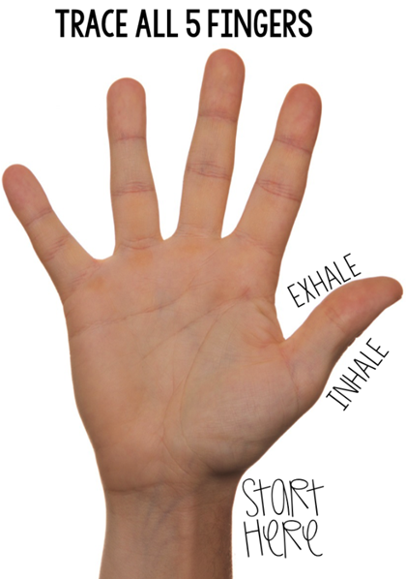
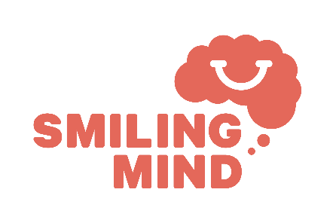



When you have been ill, you might find that you aren't as strong as you used to be, and your muscles might ache or be painful. It can be helpful to take things slowly, relax, and take deep breathes to help with pain.
Other things that can help when you are in pain are:
Positive self-talk and telling yourself things like “I can do this”, “this will get better” out loud
Deep breathing exercises (have a look at the apps below!)
Distracting yourself with calming activities you enjoy
Telling an adult like family and teachers
Taking any medication as early on as possible (it works better if you take it before the pain gets bad)
Pain can make all of these things feel hard. It’s important to start small and build up to bigger things gently.
When you have been unwell, slowly increasing the number of things you do can be a good idea to help your body get stronger. You might not want to move but it’s important for you to stay active as much as you can. It is important to start off slowly, you might go for a small walk with a parent who can help you if you need it.

Slide 13
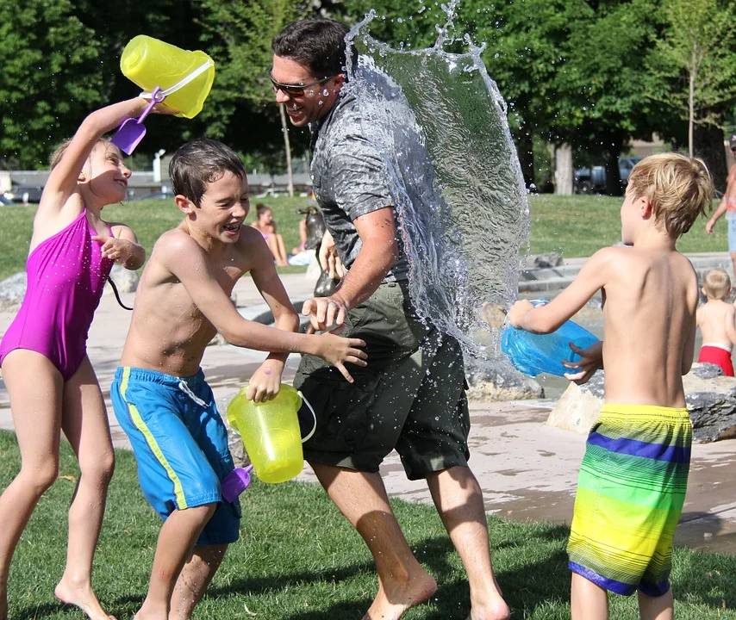


Getting Better After Illness:
Breathlessness and Coughing
It’s normal to feel breathless when you’ve been doing activities that take a lot of energy e.g. running, playing football or dancing. If you’ve had an illness you might notice you are even more out of breath than normal.
For most people, breathlessness will go away eventually.
If your breathlessness doesn’t calm down when you’ve had a rest it’s really important to let the adults around you know.
As you get stronger, your breathlessness should get better and over time will go. You will be able to run as fast, dance for as long, and sing as loud as you could before!
You might notice that things you used to be able to do without feeling breathless, feel a bit different. You might not be able to run as fast, or dance for as long, or sing as loud as you did before.
Breathlessness will usually go away after time. If it sticks around it could be because your lungs were working very hard to keep you well when you are poorly, and they are just a bit tired.

Slide 14
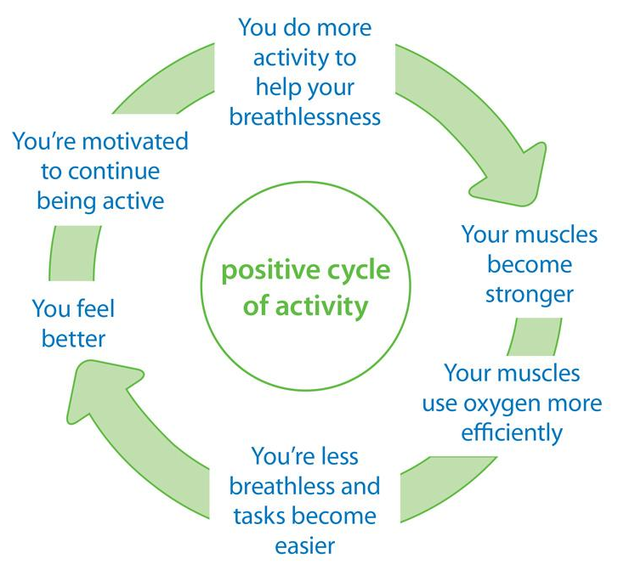
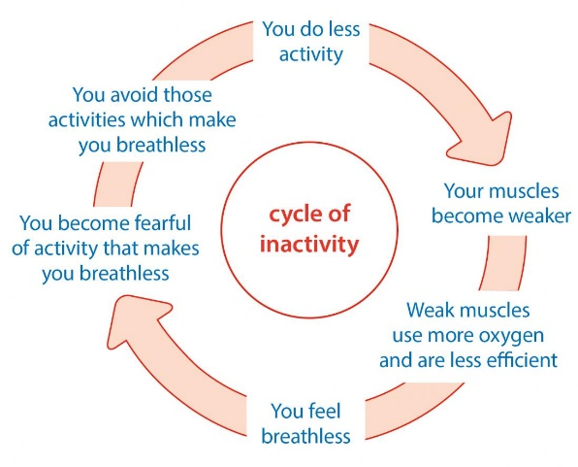

Coughing
Breathlessness
A cough is a reaction your body has which helps clear your throat and lungs.
It’s normal for cough to stay around for a while after being ill.
Breathlessness can feel like when you are trying to breathe but can’t get lots of air in. Breathlessness can get in the way of things you want to do, but it’s important to try to keep doing some activity or light exercise.
Changing the position your body is in can help when you are breathless.
Sometimes when we have breathlessness, this can be linked to feeling anxious or worried. Have a look at our ‘Coping with Difficult Thoughts and Feelings’ resource for help with this.
You could drink something warm (but not too hot!) to soothe your throat, like hot water with lemon and honey. You can also buy something called lozenges from the shop, which have ingredients that help to soothe a cough or sore throat.
If when you cough something comes up in your mouth it’s important to let the adults around you know. They might be able to give you medicines to help with this.
Images taken from British Lung Foundation | The UK’s lung charity (blf.org.uk)

Slide 15



Getting Better After Illness:
Top Tips for Parents/Carers
It can be really scary when your child isn’t feeling well, and we understand that you will be worried
The symptoms your child has will resolve (almost always)
Find a good balance right between prompting children to do things that will help, versus allowing them rest time
Recovering from illness takes time. Reminding your child of this whilst talking confidently and positively will help them feel contained and supported
If you’re hopeful and confident, this will help your child feel this way too. You can say things like “it’s okay, you will get better, and it is normal to feel this way when your body is trying to get better”
Look after yourself too!
Work with your child’s school to support them, and speak to your GP for help with fatigue and brain fog in particular
Routine, structure, healthy eating, hydration, and structured bedtimes are always
important, but can be especially helpful after illness. It might be useful to provide written or visual instructions too.
Show this page to your parents/carers

Slide 16



Getting Better After Illness:
Top Tips for Teachers
Allowing regular breaks to manage energy levels
Access to refreshments
Offer 1:1 support where possible
Place demands that are appropriate and not too overwhelming
Help to balance workloads. Children may have less capacity to do what they were able to before illness.
Provide quiet, calming spaces to rest and relax if need be, without embarrassment or judgement
Lessen the cognitive load by giving clear expectations for work and written worksheets instead of copying things of the board.
Make sure live lessons and recordings are available where possible
Offer reassurance that things will shift eventually
Maintain contact with peers
Show this page to your teachers!

