Slide 1
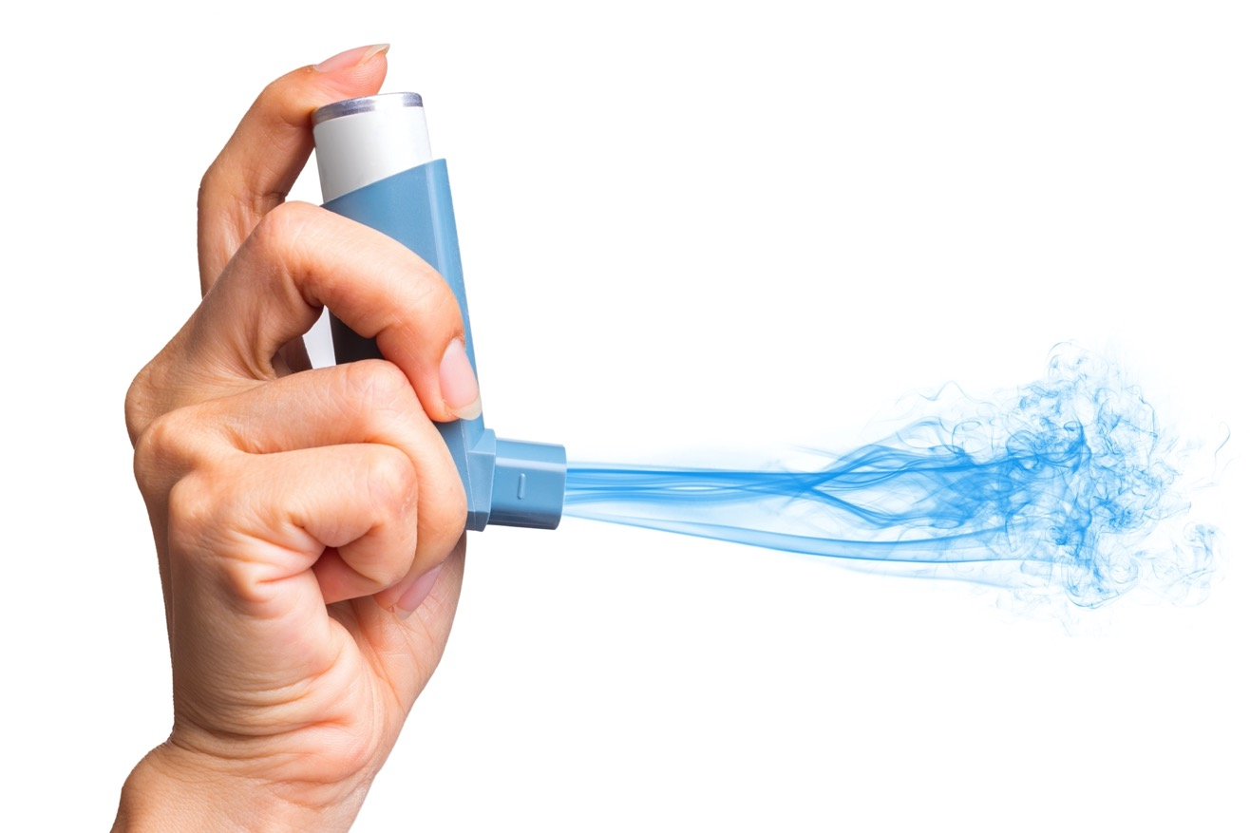

Sustainable Inhaler Prescribing
Tackling the climate crisis through sustainable inhaler prescribing.
allwales.icst.org.uk

Slide 2

The environmental impact of healthcare…
If the healthcare sector were a country, it would be the fifth largest global greenhouse gas emitter on the planet
Climate change is not just the greatest health threat it is also the greatest health opportunity of this century
Millions of lives can be saved from the health benefits of more ambitious climate action
allwales.icst.org.uk

Slide 3




PRINCIPLES OF SUSTAINABLE HEALTHCARE
Prevention
Self care
Lean pathways
Low carbon alternatives
Promoting health and preventing disease by tackling the causes of illness and inequalities
Empowering patients to take a greater role in managing their own health and healthcare
Streamlining care systems to minimise wasteful activities
Prioritising treatments and technologies with a lower environmental impact

Slide 4





What is being done in Wales to support sustainable healthcare?
Green Health Wales is a network of healthcare professionals across Wales making headway on national sustainable healthcare improvements. Contact info@greenhealthwales.co.uk to join the network.
Greener Primary Care is a Framework and Award Scheme being developed by Public Health Wales to support General Practices, Community Pharmacies, Community Optometric Practices and Dental Primary Care Practices to implement a range of environmental sustainability actions including prescribing actions (due March 2022). Practices are awarded Bronze, Silver, Gold or Platinum level; depending on the number of actions they achieve. Contact Angharad.Woolridge@wales.nhs.uk to register interest or become a pilot practice.
Greener Practice Wales, a new and evolving group has GP & GP trainee members from all over Wales. Members use the secure web based platform to network and share ideas. Please contact greenerpracticewales@gmail.com if you wish to join the group.
All Wales ICST programme which is a freely accessible, comprehensive package including education tutorials, events, case-based assessment and certificate, communications and other resources, to make it easier to make more sustainable inhaler prescribing choices. Visit allwales.icst.org.uk for more information.
All Wales Therapeutics & Toxicology Centre (AWTTC) are developing an inhaler dashboard to help practices identify and consider prescribing low carbon inhaler alternatives.
allwales.icst.org.uk

Slide 5
Health and Social Care Carbon Emissions (2018 report)

Slide 6


Environmental Impact of Metered Dose Inhalers
Carbon footprint of all inhalers in Wales 59,891 tonnes eq CO₂
Equivalent to 159 million passenger air miles, or a flight to the sun and back

Slide 7
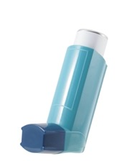

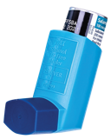


Ventolin™ evohaler
(MDI)
Salamol™ evohaler
(MDI)
Dry Powder Inhaler
(DPI)
28kgCO₂ eq per inhaler
10kgCO₂ eq per inhaler
<1kgCO₂ eq per inhaler
Inhaler comparison
Metered Dose Inhalers contain hydrofluorocarbon as propellants. Although not ozone depleting, HFCs are still potent greenhouse gases.
Dry powder inhalers do not contain this propellant, and have a much lower global warming potential.
Some MDIs are smaller volume, such as Salamol™, and contain less HFC propellant.

Slide 8
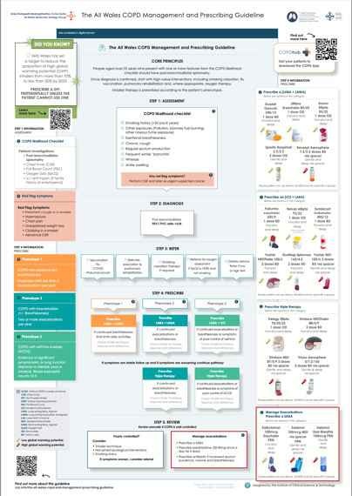

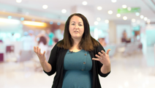
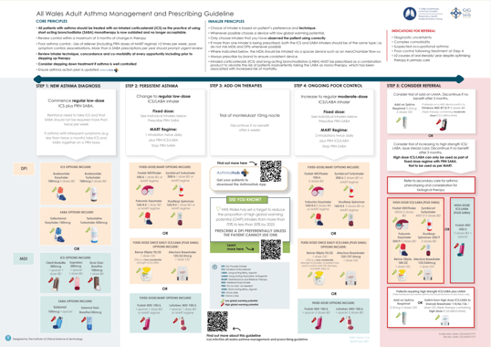
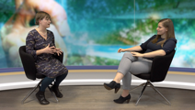
All Wales Guidelines
(available on the All Wales ICST platform, including printed copies delivered to your practice on request)
The All Wales Guidelines for the Management of COPD and Asthma provide guidance on the inhalers with higher and lower global warming potential
These are interactive, dynamic guidelines to support teams to make the switch to lower carbon alternatives
Supplemental education and instruction from the experts in Wales
allwales.icst.org.uk

Slide 9
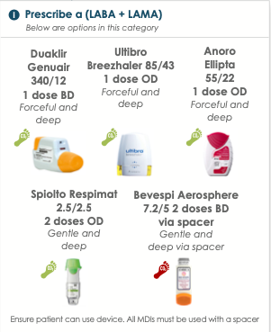
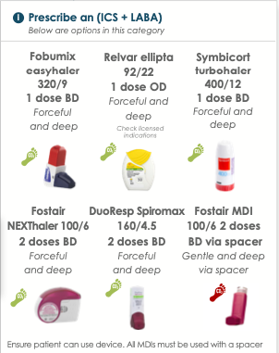
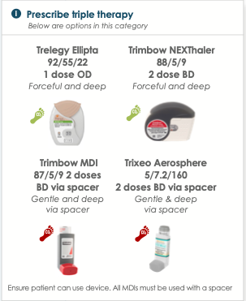
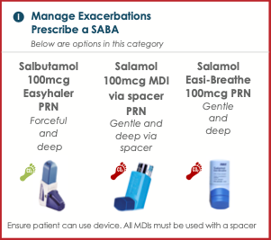
Examples of lower carbon alternatives
Taken from the All Wales COPD Management and Prescribing Guideline
allwales.icst.org.uk

Slide 10



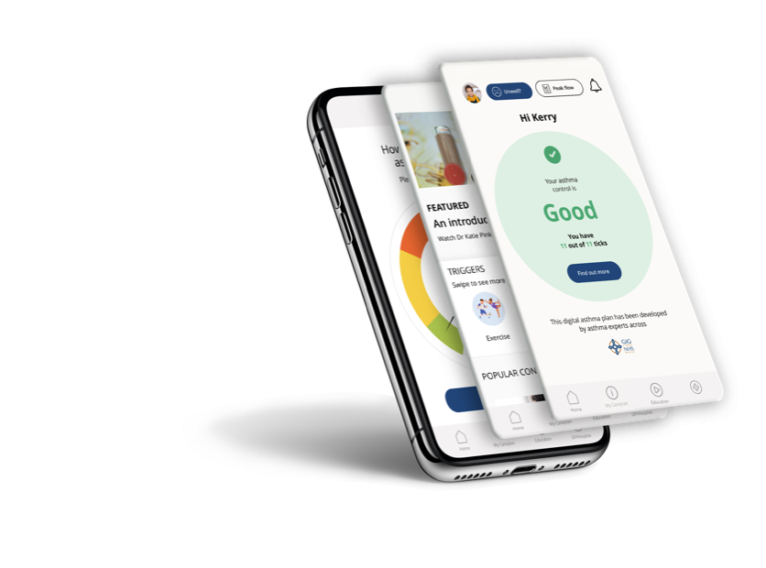
Respiratory patient apps
A campaign to raise awareness of the environmental impact of inhalers, delivered by NHS Wales experts, and published to the NHS Wales Respiratory apps
Encouraging patients to discuss with their GP, specialist nurse or community pharmacist whether they would be suitable for the switch
Inhaler technique videos available on the app, to support the switch
Monitoring of disease control through the app, with PEF diaries and a personalised asthma/ COPD action plan

Slide 11

Scriptswitch
Switch from Ventolin Evohaler to lower carbon alternative MDIs such as Salamol Evohaler
Immediate and requires little effort, needing limited active follow up unless patients encounter problems
Make sure everyone on the team knows what's being done and why
allwales.icst.org.uk

Slide 12
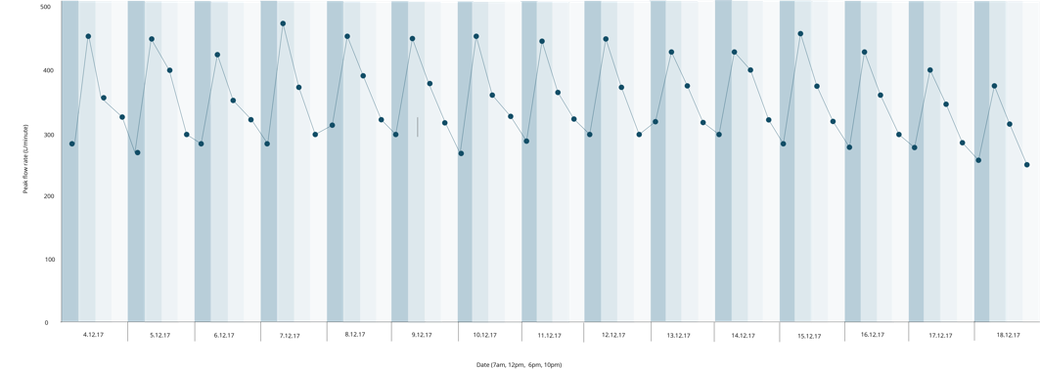
Improving disease control:
Importance of preventer therapy over reliever therapy
Every patient with asthma discuss and agree a personalised action plan
Empower patients to take control of their asthma using the NHS Wales Asthmahub or Asthmahub for parents apps
Any patient with poor symptom control, excessive use of reliever therapy (>3/week), should be considered for stepping up in inhaled therapy

Slide 13
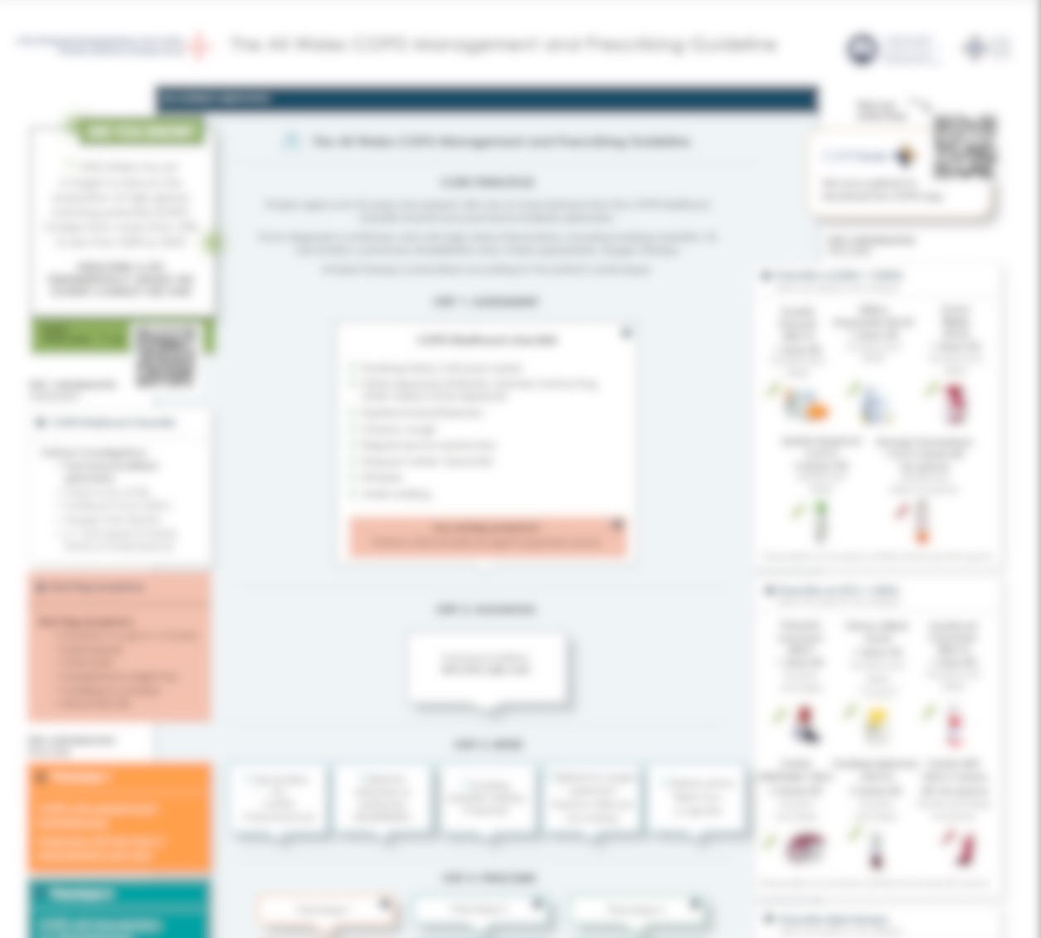
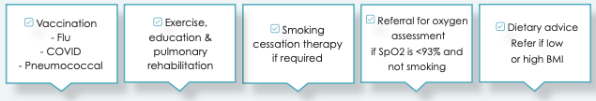
Focusing on high-value interventions for COPD
These interventions have a higher Quality Adjusted Life Year (QALY) for patients with COPD than inhaled therapies
Ensure every patient with COPD is considered for these interventions at every opportunity
Empower patients with COPD to take control of their condition with the support of the NHS Wales COPDhub app

Slide 14
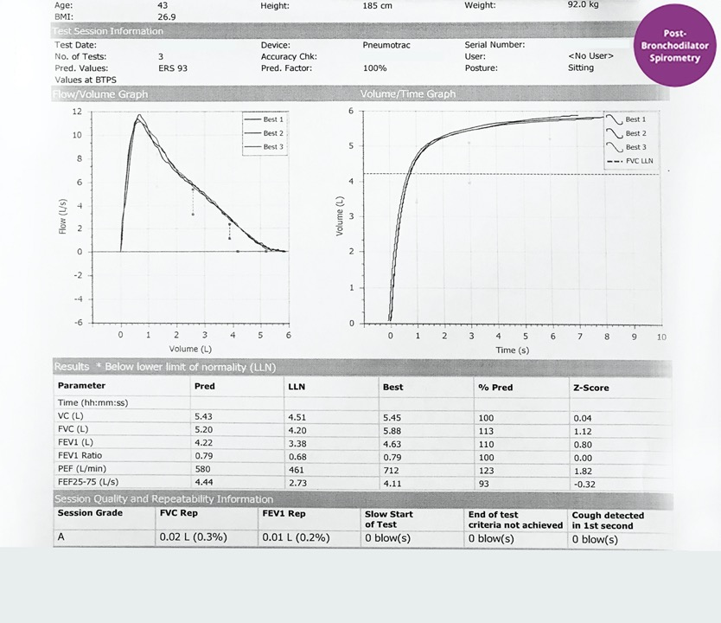
Getting the diagnosis right
Ensure that the patient has the right diagnosis
One in four patients on COPD registers in Wales do not have a record of post-bronchodilator spirometry, and therefore could be misdiagnosed and on unnecessary inhaled therapies

Slide 15
Any questions?

